Slide 1
Typography Usability & Readability
Obj. 1.01

Slide 2
What’s the personality?
Font choice should convey the meaning or personality that matches the purpose of the design
Examples:
Sympathy Card – Script
Flyer Heading – Decorative
Which typeface is more effective?
Notes:
The top typeface is more effective because it conveys a more serious personality that matches the purpose of the design.

Slide 3
Where do I start?
Font choice should give visual clues about the order text should be read
Visual Hierarchy - an arrangement of text in a graduated series to help readers scan and know where to enter and exit the text
Create hierarchy through
Repetition
Contrast
Changes in weight, scale, positioning, color, tone, spacing, or font
Examples:
Headline larger than subheadings
Using bold, italics, and color for emphasis

Slide 4
Example of Visual Heirarchy
YOU WILL READ THIS FIRST
You will read this when skimming
You will probably not read this on a skim.
You will probably not read this unless a phrase is bolded.
Your eye will be drawn to this before leaving the page because of contrast in font category and color.

Slide 5
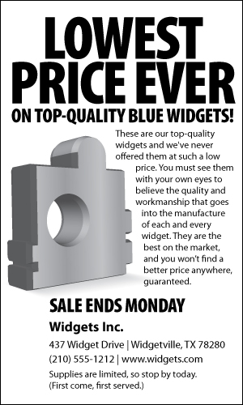
Example of Visual Hierarchy

Slide 6
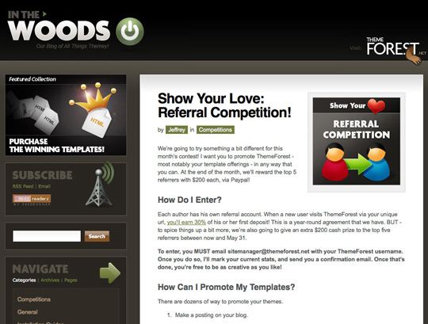
Example of Visual Hierarchy
Headings formatted differently than body text

Slide 7
Too many fonts spoil the design
Font choice should be limited to 2 or 3 fonts
Too many font choices can be distracting
Do not mix 2 fonts from the same category
Example: Times New Roman for a heading and Palatino for a subheading; 2 serif fonts
Too many fonts used in this example

Slide 8
Good use of font pairing
Attitude
is everything!
Sans Serif paired with a Script typeface

Slide 9
Who is my reader?
Font choice should consider the target audience
Young readers need fonts that accurately display letters
Example: The lowercase “a” in Arial is not displayed the way young readers learn to write the letter “a” making the font difficult to read
Teen readers enjoy fonts with a modern or edgy feel

Slide 10
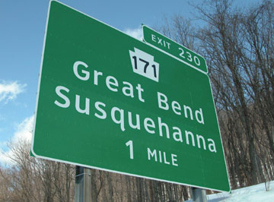
Readability
Consider the target audience
Clearview typeface for highway signs

Slide 11
Is the font for digital or print display?
Consider the medium –
Test the font to see if it is legible on the intended output
Test the Size – the vertical height of a character
Test the Style – bold, italic, fill color, stroke color, shadow, small caps
Test the Spacing
Leading – vertical spacing between of lines of text
Kerning – horizontal spacing between pairs of letters
Tracking – horizontal spacing between all the characters in a large block of text.
Notes:
Just because you fall in love with a font does not mean it is the best choice. Always test readability.

Slide 12
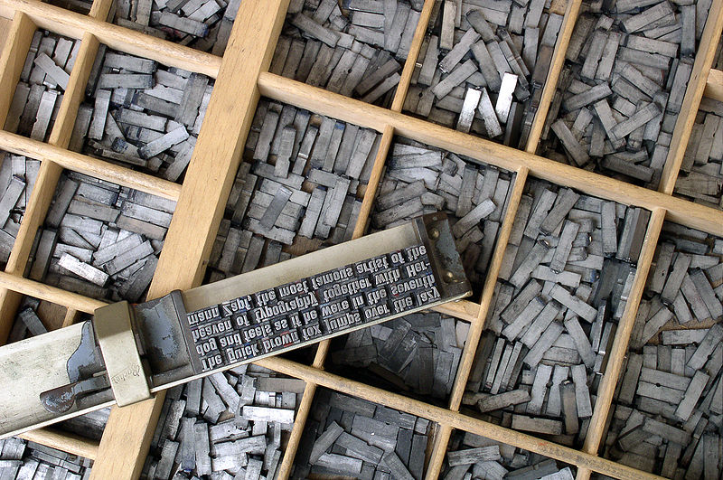
Leading
Vertical spacing between lines of text.
Pronounced “led-ding.”
Referred to as line spacing
Single Space
Double Space
Used to:
Slightly increase or decrease the length of a column so that it is even with an adjacent column
To force a block of text to fit in a space that is larger or smaller than the text block

Slide 13
Leading
Look in the nook to find
the book that you
borrowed to read.
Leading (vertical spacing between lines of text)
Leading (vertical spacing between lines of text)

Slide 14
Kerning
Horizontal spacing between pairs of letters
Used create a more visually appealing and readable text.
BOOK – before kerning.
– after kerning the O’s.
Notes:
Kerning is most often used with text which has been enlarged since this tends to create too much space between individual letters.

Slide 15
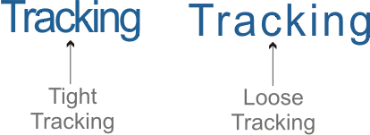
Tracking
Horizontal spacing between all characters in a large block of text.
Makes a block of text more open and airy or more dense.
Used to expand or contract a block of text for the purpose of aligning two columns.

Slide 16
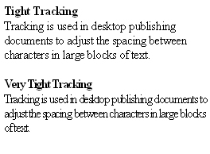
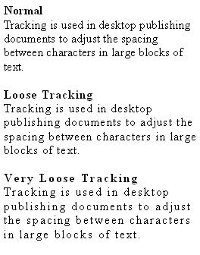
Examples of Tracking

Slide 17
Kerning, Leading, Tracking
LOOK in the nook to find the book that you borrowed to read.
Kerning (horizontal spacing between pairs of letters)
Leading (vertical spacing between lines of text)
Tracking (horizontal spacing between all characters in a large block of text.

