Slide 1
Multiuse Principles of Design
1.01 Understand typography, multiuse design principles and elements.

Slide 2
Multiuse Principles of Design
Used to arrange the elements of design
Can have an impact on the effect of the design
Balance
Contrast
Unity/Harmony
Scale/Proportion
Dominance/Emphasis

Slide 3
Balance
The arrangement of elements
Three types:
Symmetrical
Asymmetrical
Radial

Slide 4
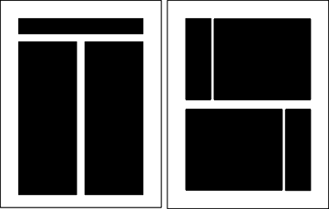
Symmetrical Balance
Elements are centered or evenly divided both vertically and horizontally

Slide 5
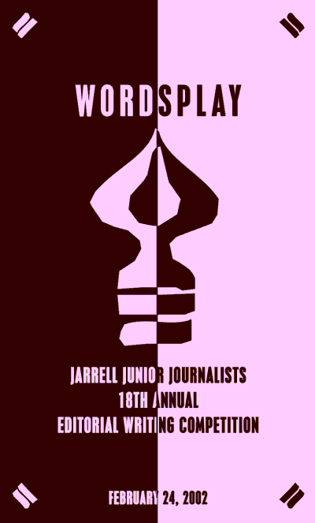
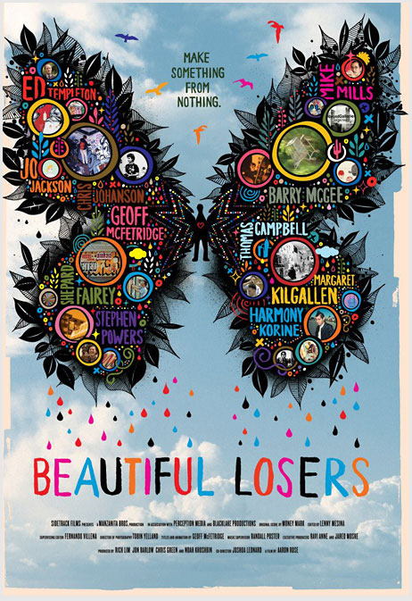

Slide 6
Asymmetrical Balance
Off-center alignment created with an odd or mismatched number of elements.

Slide 7
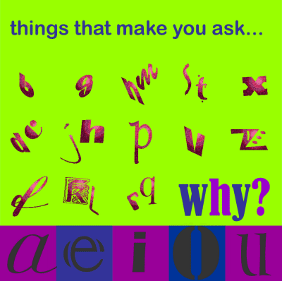
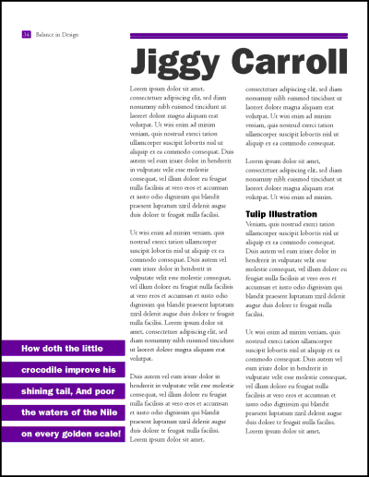
Examples

Slide 8
Radial Balance
the elements radiate from or swirl in a circular or spiral path.

Slide 9
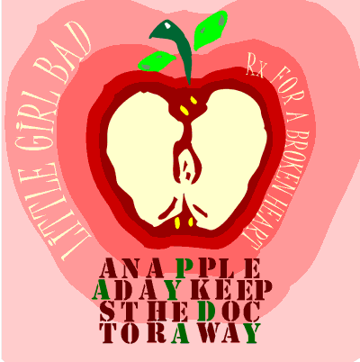
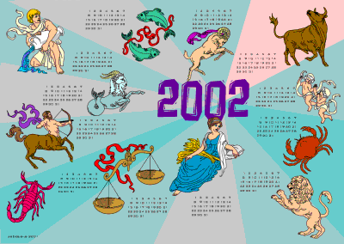
Examples

Slide 10
Contrast
Emphasizing the difference between elements
Creates interest and excitement
Examples: red and white, squares and circles, rough and smooth textures

Slide 11
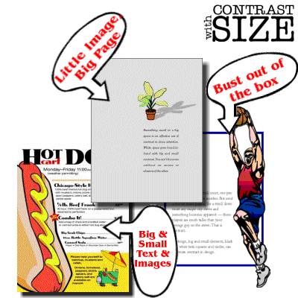

Slide 12
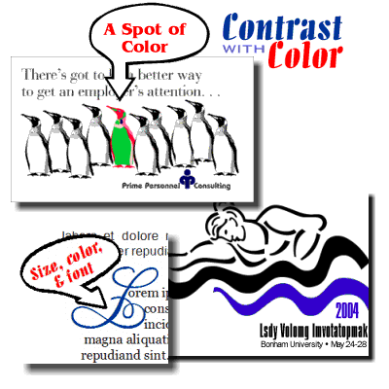

Slide 13
Unity/Harmony
All of the design elements are consistent with each other in shape, style and color and consistent with the overall message
Helps the reader understand the whole message
Can be achieved through repetition/consistency
Examples:
Using consistent font scheme or repeated shape throughout
Using lines to connect

Slide 14
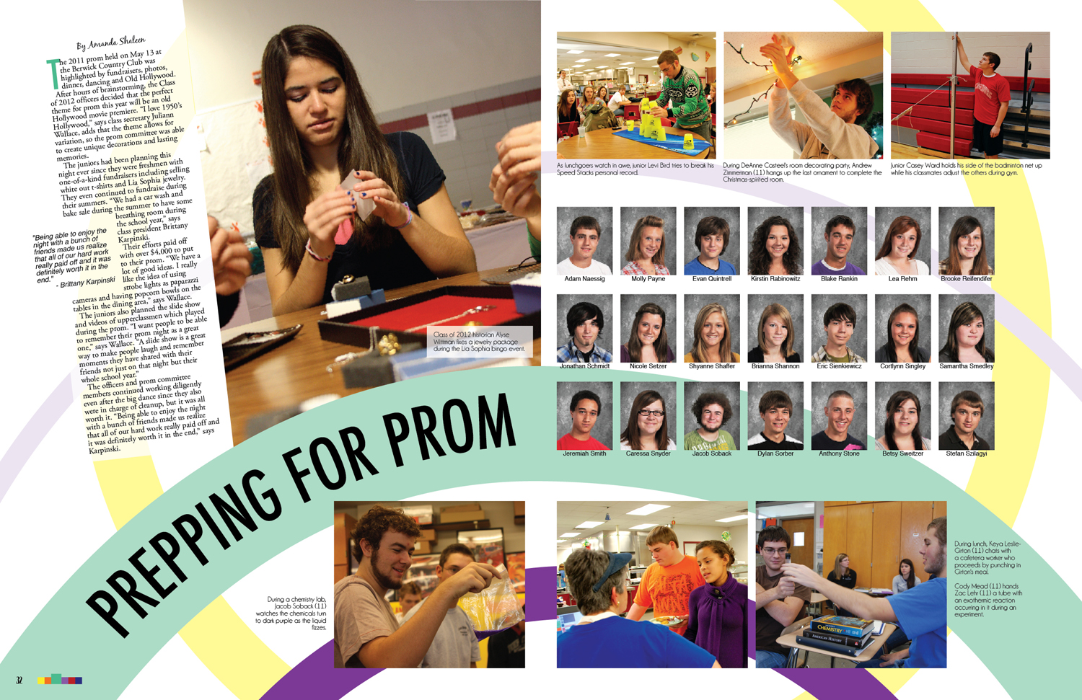
Example
Notes:
Repeated shapes throughout

Slide 15
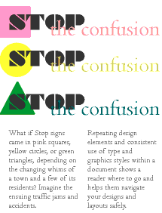
Example
Notes:
Consistent font scheme

Slide 16
Notes:
Repetition/consistency in headings, subheadings, and font scheme
Unity/Harmony exists with color choices and images

Slide 17
Scale/Proportion
the relationships between the sizes of various elements
Creates visual impact and aids readability
Examples:
Headline larger than body text
Exaggerating the size of a design element

Slide 18
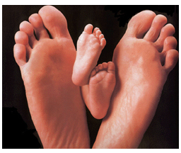
Example

Slide 19
Dominance/Emphasis
the first element the eye sees; the focal point
Gets the viewer’s attention
Assures the viewer starts in the correct order
Examples
Splash of color
Shocking image or text

Slide 21
Design Compositions
These concepts will help you arrange elements and use design principles effectively
Grids
Rule of Thirds
Optical Center
Z - Pattern

Slide 22
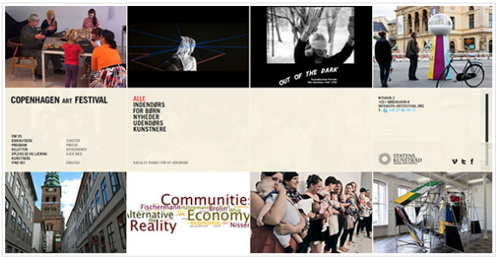
Grids
The use of columns/rows in design
Used frequently in print and web design
Copenhagen Art Festival Web Page

Slide 23
The Rule of Thirds
Splitting an image or design into thirds, so you end up with 9 equal sections
Place the focal point along a line or where the lines intersect

Slide 24
Rule of Thirds

Slide 25
Optical Center
the spot the eye first sees when it encounters a page
slightly above and to the right of the actual center
Place the most important design element here.
Notes:
Teacher Note: Look through magazines to find advertisements that illustrate the Rule of Thirds, Optical Center and Z-pattern and use these to illustrate these concepts to your students.

Slide 26
Z Pattern
the pattern the eye follows when scanning a page.
Place important elements along the Z-pattern.
1
2
3
Z
Optical Center
Z-Pattern

Slide 27
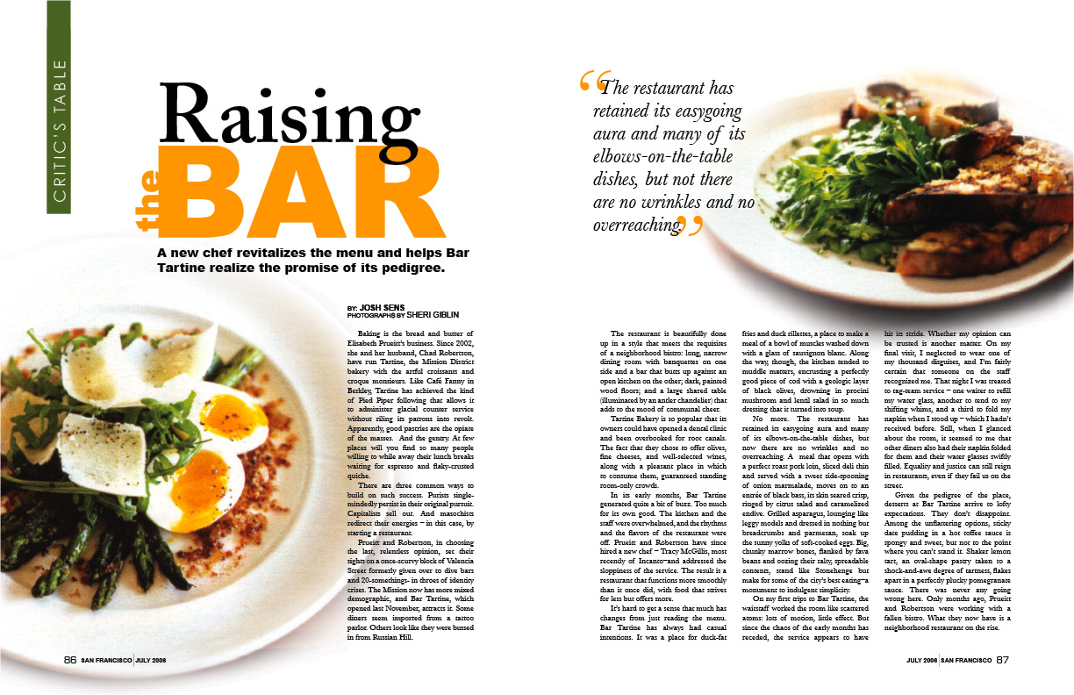
Think – Pair - Share
Notes:
Have students review the design pictured here.
Steps:
Students will think about the design principles present in this design.
Students will pair with a neighbor to discuss their thoughts.
Students will share their thoughts with the class. Teacher will facilitate this discussion to make sure students understand the concepts.

