Slide 1

Collecting and processing of information
Presentation 4.5.1
© 2011 International Technology and Engineering Educators Association,
STEMCenter for Teaching and Learning™
Foundations of Technology

Slide 2

Data Chat
The Unit Big Idea
The Engineering Design process is a systematic, iterative problem solving method which produces solutions to meet human wants and desires.
© 2011 International Technology and Engineering Educators Association,
STEMCenter for Teaching and Learning™
Foundations of Technology

Slide 3
Data Chat
The Lesson Big Idea
Computers assist in organizing and analyzing data used in the engineering design process.
© 2011 International Technology and Engineering Educators Association,
STEMCenter for Teaching and Learning™
Foundations of Technology

Slide 4
Data Chat
Why do we need Data?
Throughout the design process, the design needs to be continually checked and critiqued, and the ideas of the design must be redefined and improved.
Statistics can be used to help optimization of designs and improve efficiency.
© 2011 International Technology and Engineering Educators Association,
STEMCenter for Teaching and Learning™
Foundations of Technology

Slide 5
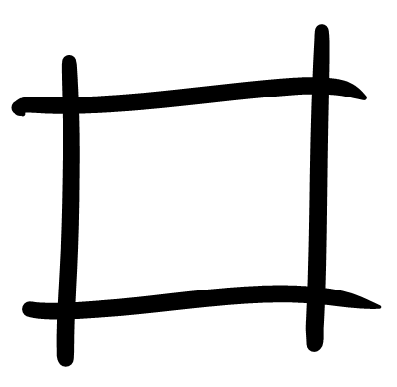



Statistics
Statistics is numerical data collected, organized and analyzed.
Statistic Analysis
Statistics in
Manufacturing
© 2011 International Technology and Engineering Educators Association,
STEMCenter for Teaching and Learning™
Foundations of Technology
Notes:
The text box on the left links to the slide on computers assisting with data. Select the images or text to move to the slide related to statistic analysis or manufacturing

Slide 6
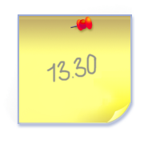


Statistic Analysis
mean
median
mode
standard deviation
range
tolerance
1, 3, 5,8, 8
Back to Menu
© 2011 International Technology and Engineering Educators Association,
STEMCenter for Teaching and Learning™
Foundations of Technology
Notes:
There is a hyperlink for each statistic term to link to the appropriate slide.

Slide 7
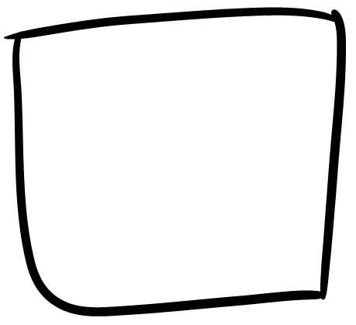
Statistics in Manufacturing
  upper specification limit
  lower specification limit
Back to Menu
© 2011 International Technology and Engineering Educators Association,
STEMCenter for Teaching and Learning™
Foundations of Technology
Notes:
There is a hyperlink for each statistic term to link to the appropriate slide.

Slide 8
Statistic Analysis
Data Set
1, 3, 5,8, 8
Mean
The mean represents the average of a set of data.
To calculate mean you sum all the given elements in a data set and divide by the number of items in the data set.
Mean= (1+3+5+8+8) 5
= 5
Back to Menu
© 2011 International Technology and Engineering Educators Association,
STEMCenter for Teaching and Learning™
Foundations of Technology

Slide 9
Statistic Analysis
Data Set
1, 3, 5,8, 8
Median
Median is the middle number in a given data set. When the data set has an even number of elements, the median is the average of the two middle numbers.
Median: 5
Back to Menu
© 2011 International Technology and Engineering Educators Association,
STEMCenter for Teaching and Learning™
Foundations of Technology

Slide 10
Statistic Analysis
Data Set
1, 3, 5,8, 8
Mode
Mode is the most frequently occurring number in a data set. It is possible to have more than one mode.
Mode: 8
Back to Menu
© 2011 International Technology and Engineering Educators Association,
STEMCenter for Teaching and Learning™
Foundations of Technology

Slide 11
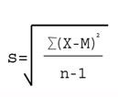
Statistic Analysis
Data Set
1, 3, 5,8, 8
Standard Deviation
Standard deviation represents the spread of a set of data. The higher the number, the larger the spread of data.
Standard deviation is calculated using the following formula:
(x-mean) for each value in data set
(1-5) = -4
(3-5) = -2
(5-5) = 0
(8-5) = 3
(8-5) = 3
∑(mean-x)² = -4² + -2² + 0² + 3² + 3² = 38
∑(x-mean)²/N-1 = 38/4 = 9.5
√ ∑(x-mean)²/N-1 = 3.08
Standard Deviation:3.08
Back to Menu
© 2011 International Technology and Engineering Educators Association,
STEMCenter for Teaching and Learning™
Foundations of Technology

Slide 12
Statistic Analysis
Data Set
1, 3, 5,8, 8
Range
Range represents the maximum value in the data set subtracted by the minimum value in the data set.
8-1 = 7 = Range
Back to Menu
© 2011 International Technology and Engineering Educators Association,
STEMCenter for Teaching and Learning™
Foundations of Technology

Slide 13
Statistic Analysis
Data Set
1, 3, 5,8, 8
Tolerance
Tolerance represents the possibility of error in measurements for a data set.
Tolerance is calculated by half of the range.
Range/2 =
7/2 = 3.5
Back to Menu
© 2011 International Technology and Engineering Educators Association,
STEMCenter for Teaching and Learning™
Foundations of Technology

Slide 14
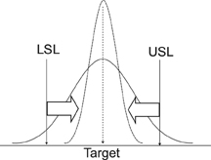



Statistics in Manufacturing
Upper Specification Limits
Upper specification limit is the largest measurement a part of clearance space is allowed, so that the part still functions.
The desired size of your part
Back to Menu
© 2011 International Technology and Engineering Educators Association,
STEMCenter for Teaching and Learning™
Foundations of Technology

Slide 15
Statistics in Manufacturing
Lower Specification Limits
Lower specification limit is the smallest measurement a part of clearance space is allowed, so that the part still functions.
The desired size of your part
Back to Menu
© 2011 International Technology and Engineering Educators Association,
STEMCenter for Teaching and Learning™
Foundations of Technology

Slide 16
Practice
In your Engineering Design Journals, calculate the following for the data set on the left:
Mean
Median
Mode
Standard Deviation
Range
Tolerance
Data Set
4, 6, 6,10, 12
© 2011 International Technology and Engineering Educators Association,
STEMCenter for Teaching and Learning™
Foundations of Technology

Slide 17

Computers & Statistics
As you experienced in the exploration activity, you can enter formulas into Excel to assist you with calculations.
To evaluate data and information in order to communicate, computers and calculators can be used to access, retrieve, organize process, maintain, and interpret.
Microsoft Excel is a common program used to enter and formulate data.
Back to Menu
© 2011 International Technology and Engineering Educators Association,
STEMCenter for Teaching and Learning™
Foundations of Technology

