Slide 1
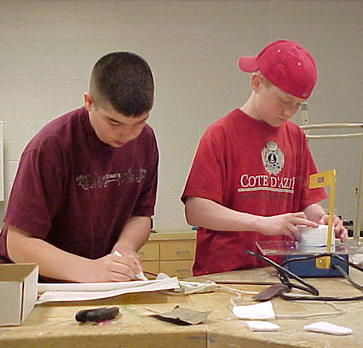
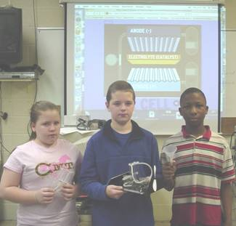
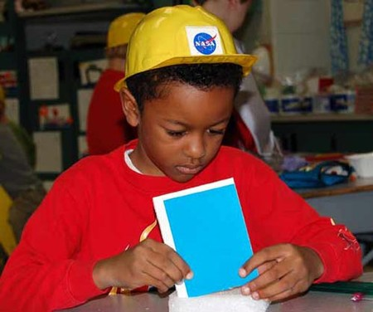
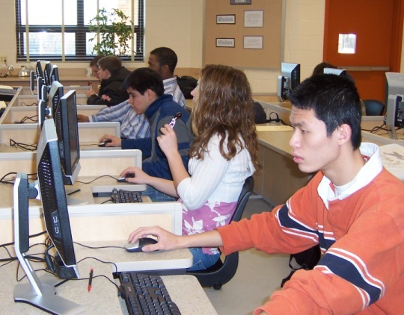
[Foundations of Technology, Third Edition Technology, Engineering, and Design
Presentation 1.1.1
Notes:
TITLE SLIDE
On this slide, specialists should insert the logo of the agency where you are visiting. This is usually accessed from the website. When arranging the speaking engagement, ask for a tif or jpg of the logo.
POST TITLE SLIDE:
When arriving at the workshop site, this slide should be on the screen approximately 10 – 15 minutes before the workshop begins.
SPECIAL NOTE:
We are now the STEM Center for Teaching & Learning. Our focus is on teaching and learning.

Slide 2
Reflection
Case Study: Automobile
Computers
Evolution of Products
Evolutionary Nature of Technology
Notes:
Click on data point or data description to move to section in PowerPoint.

Slide 3
Evolution of Products
Most technological development has been evolutionary, the result of a series of refinements to a basic invention.
Invention vs. Innovation
Notes:
Explain the difference between invention (completely new product) and innovation (an improvement on a product).

Slide 4
A Case Study in Evolution
The Automobile
In 1901, the Olds automobile factory began production with a three-horsepower Oldsmobile for $650.
In 1902, standard brake drums were invented, the basis for today’s disc brakes.
In 1908, Henry Ford mass-produced the Model T Ford.

Slide 5
A Case Study in Evolution
In 1911, the electric starter was invented.
In 1914, Dodge introduced the first full-steel body.
In 1919, the first single pedal to operate the four-wheel brakes was added.
In 1926, the first power steering system using hydraulics became available.

Slide 6
A Case Study in Evolution
In 1939, the first air conditioning units were added.
In 1966, a electronic fuel injection system was developed in Britain.
In 1992, the government supports alternative- energy-fuel vehicles.

Slide 7
Reflection
How does the example of the automobile support the statement that most technological development has been evolutionary, the result of a series of refinements to a basic invention?
What was the basic invention that has evolved into the modern automobile?
What is the future of automobile innovation?

Slide 8
Computers
Computers are another example of the evolutionary nature of technology.
Computers have become invaluable in science, mathematics, and technology because they speed up and extend people’s ability to collect, store, compile, and analyze data; prepare research reports, and share data and ideas with investigators all over the world.

Slide 9
Computers
Research the evolution of computers using the resources provided to you. Be prepared to share with a classmate:
the original invention from which the computer has evolved
five different significant events in the evolution of the computer
Notes:
The research can be assigned as a homework assignment or appropriate articles could be provided or time in a computer lab to research online.

Slide 10
References

