Slide 1
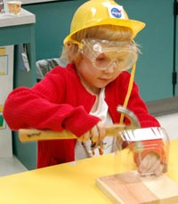
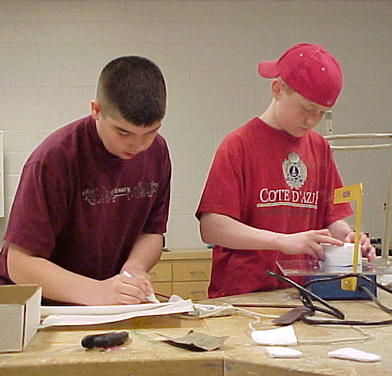
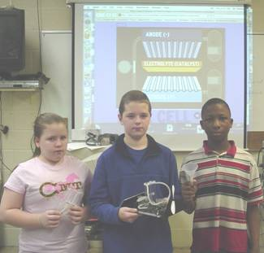
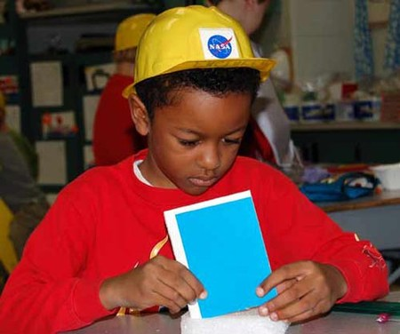
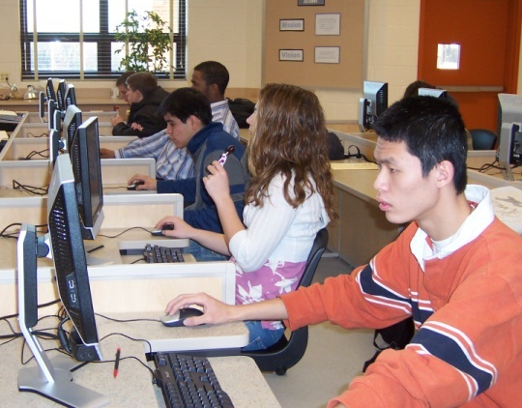
Foundations of Technology, Third Edition/ Technology, Engineering, and Design
Presentation 1.2.1
Notes:
TITLE SLIDE
On this slide, specialists should insert the logo of the agency where you are visiting. This is usually accessed from the website. When arranging the speaking engagement, ask for a tif or jpg of the logo.
POST TITLE SLIDE:
When arriving at the workshop site, this slide should be on the screen approximately 10 – 15 minutes before the workshop begins.
SPECIAL NOTE:
We are now the STEM Center for Teaching & Learning. Our focus is on teaching and learning.

Slide 2
Technology
Transfer
Notes:
Click on soccer ball, NASA logo and robotics for examples of technology transfer
Click on main image for description of technology transfer
Click on ? Button for further impacts of technology transfer

Slide 3
What is Technology Transfer?
Often new technologies lead to a new process or a change in how processes and products are invented.
Technology transfer occurs when a new user applies an existing innovation developed for one purpose in a different function.

Slide 4
Example: Soccer Ball
As you know, a geodesic dome is constructed of a series of triangles assembled to create a sphere-shaped structure.
Buckminster Fuller applied the
geodesic dome design to
patent a new and
improved soccer ball, the
“buckyball.”

Slide 5
Example: Robotics
Robotics is the most common example of a new technology that affects how other products are created.
View the following video for a demonstration of how robotics changed the manufacturing of automobiles. http://www.youtube.com/watch?v=nvZBtJ-ncEM&feature=related
Reflection

Slide 6
Reflection
Before robotics, how would the assembly of the car bodies had to have been done?
What are some other impacts of replacing human workers with technology?

Slide 7
Example: NASA Spinoffs
Many technologies developed by NASA for use in its aerospace program become used for common products here on Earth.
Examples include: cooling suits, insulation for pipelines, flame-resistant textiles.
More information on NASA spinoffs can be found at: http://www.sti.nasa.gov/tto/index.html
Notes:
NASA, Jones. (2010, March 25). NASA spinoff homepage. Retrieved from http://www.sti.nasa.gov/tto/index.html

Slide 8
Impacts of Technology Transfer
The human ability to shape the future comes from a capacity for generating knowledge and developing new technologies—and for communicating the ideas to others.
Without communicating new ideas, technology transfer would not occur, and therefore new processes and products would not be created.
Some side effects of technology transfer may turn out to be unacceptable to some of the population and therefore lead to conflict between groups.

Slide 9
References
Text Needed

