Slide 1
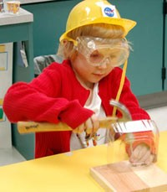
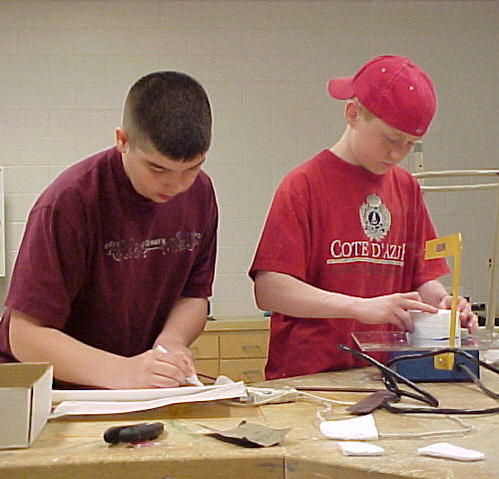
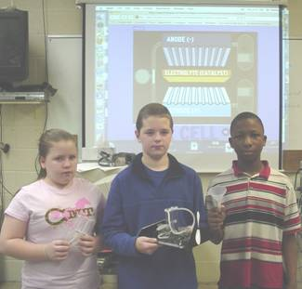
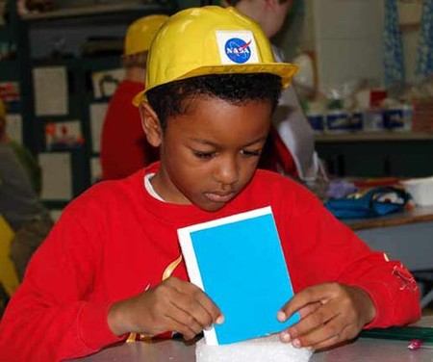



Foundations of Technology, Third Edition/
Technology, Engineering, and Design
Presentation 3.1.1

Slide 2



Main screen

Slide 3
Point 1
Mechanical Technology
  Technology of putting together mechanical parts to produce, control, and transmit motion.
  Examples:
Gears on a bicycle
Windshield wipers
Engine
Sewing machine arm

Slide 4

Point 2
Structural Technology
Technology of putting mechanical parts and materials together to create supports, containers, shelters, connectors, and functional shapes.
Examples:
Trusses on Bridge
Steel frame of skyscraper
Legs of a Chair

Slide 5
Point 3
Electrical Technology
Technology of producing, storing, controlling, transmitting, and getting work from electrical energy.
Examples:
Power to a Washing Machine
Power Transformer
Generator

Slide 6
Point 4
Electronic Technology
Technology of using small amounts of electricity for controlling; detecting; and information collecting, storing, retrieving, processing, and communicating.
Examples:
Remote Control
Mobile Phone
Circuit Board

Slide 7
Point 5
Optical Technology
Technology of producing light; using light for information collection, storage, retrieval, processing, and communication; and using light to do work.
Examples:
Lasers
Telescopes
Fiber optics

Slide 8
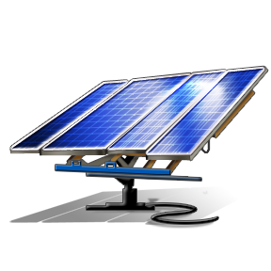
Point 6
Thermal Technology
Technology of producing, storing, controlling, transmitting, and getting work from heat energy.
Examples:
Thermos
Insulated Clothing
Solar Panels

Slide 9
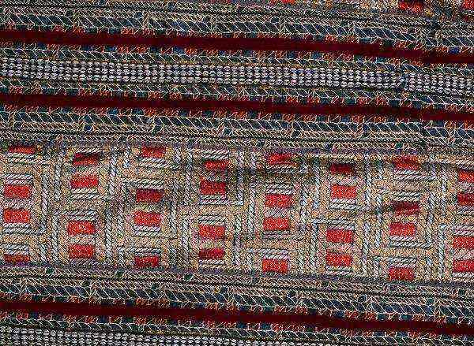
Point 7
Materials Technology
Technology of producing, altering, and combining materials.
Examples:
Welding
Metal alloys
Textiles

Slide 10
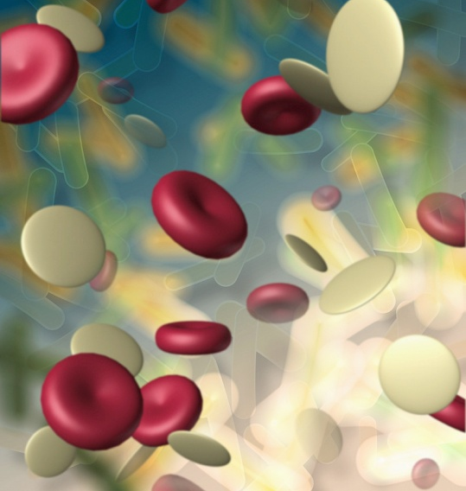
Point 8
Biotechnology
Technology of using, adapting, and altering organisms and biological processes for a desired outcome.
Examples:
Cloning
Genetically altered food
Food preservatives

Slide 11
Point 8
Fluid Technology
Technology of using fluid, either gas (pneumatics), or liquid (hydraulic) to apply force or to transport.
Examples:
Pneumatic Tools
Hydraulic Lift
Brake systems

Slide 12
Help
What are the Core Technologies?
A technology system is a group of resources (subsystems) working together to solve problems and extend human capabilities.
The core technologies are the “building blocks”
of all technology systems.
Think of them as different books on specific subjects—the combined knowledge from different books can be used to create a product or system.
Fluid
Technology

Slide 13
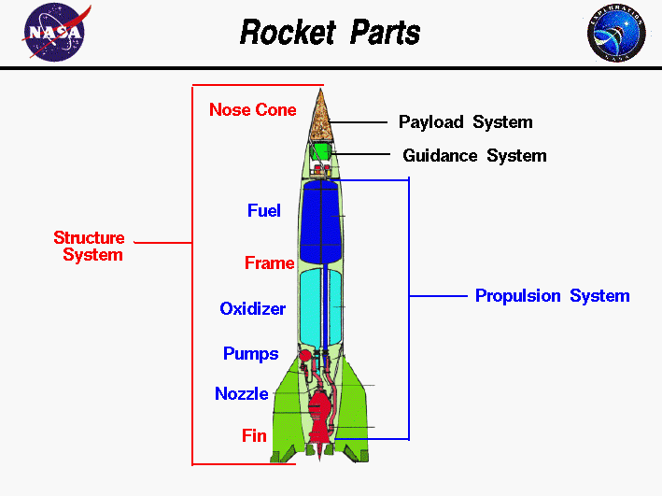
Help
What do the core technologies look like within a system?
Electronic
Technology
Structural
Technology & Material Technology
Thermal
Technology
Fluid
Technology
Notes:
NASA. Rocket parts. Retrieved on June 16, 2010 from http://microgravity.grc.nasa.gov/education/rocket/rockpart.html

Slide 14
References
Text Needed

