Slide 1
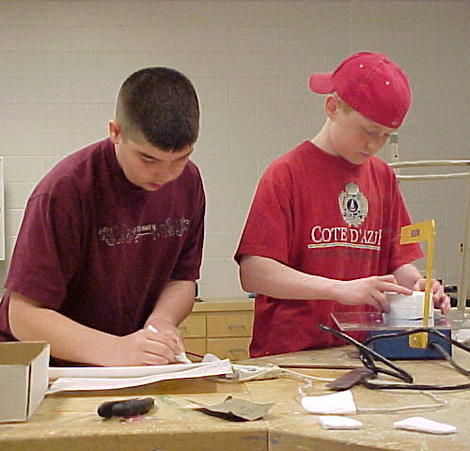
Foundations of Technology, Third Edition/ Technology, Engineering, and Design
Presentation 3.4.1

Slide 3
Product Failure
Often technological products do not always function as they are designed—to the frustration of the consumer.
Systems and products fail because they have faulty or poorly matched parts, are used in ways that exceed what was intended by the design, or were poorly designed to begin with.
Home

Slide 4
Troubleshooting
Troubleshooting is a specific form of problem solving aimed at identifying the cause of a malfunctioning system.
Troubleshooting a malfunctioning system demands considering the various parts and how those parts affect the entire system.
Troubleshooting involves a logical and orderly process of discovering the problem in a part or system.
Home
Notes:
In order to save money and time, consumers must be able to troubleshoot devices , to some level, by themselves to avoid throwing away the product only to buy a new one, or to avoid spending hours online or on the phone with product support.

Slide 5
Troubleshooting Diagrams
Troubleshooting diagrams exist for most technological products, ranging from kitchen faucets to car ignition systems, and are intended to help users solve the functional problem with the device and take appropriate action.
Home
Notes:
The first hyperlink “troubleshooting diagrams” links to the next slide.
For additional examples to include in the presentation, see suggested resources.

Slide 6
Troubleshooting Diagrams
Troubleshooting Diagrams can be:
Flowcharts
Lists of tests to perform
Conduct an Internet search to find three examples of troubleshooting diagrams. Share your examples with the class.
Step 1
Step 2
Step 3
Home

Slide 7
Manuals and Prevention
Users must maintain the safe and proper operation of the system or product.
Companies develop materials to ensure that users are able to use systems for the designed purpose, such as manuals.
The most common ways companies can prevent failure are pretesting of parts and procedures, overdesign, and redundancy.
Home
Notes:
To avoid issues where troubleshooting is necessary, users must maintain the safe and proper operation of the system or product.
Manuals are carefully developed and distributed with products for consumers to understand the limitations of the device.

Slide 8
Schematic Diagrams
Schematic diagrams are graphical representations of physical components.
Common electronic schematic representations:
Resistor
switch
LED
battery
capacitor
diode
Home
Notes:
Schematic diagrams are most often used in electronics to represent circuits.
Images taken from: http://dsnra.jpl.nasa.gov/software/xfig/
Often schematics are included with the troubleshooting diagrams to assist in assessing the malfunction.

Slide 9
References
Text Needed

